Slide 1
CoP Hackathon 2022
Team Cyber-Wyber
Problem Statement 2 – MoM-bot

Slide 2
Agenda
1
4
Team Introduction
Future Scope
Known Issues/Challenges
2
5
Proposed Solution
Learnings
What have we learnt?
3
6
Demo
Actions
Courses

Slide 3
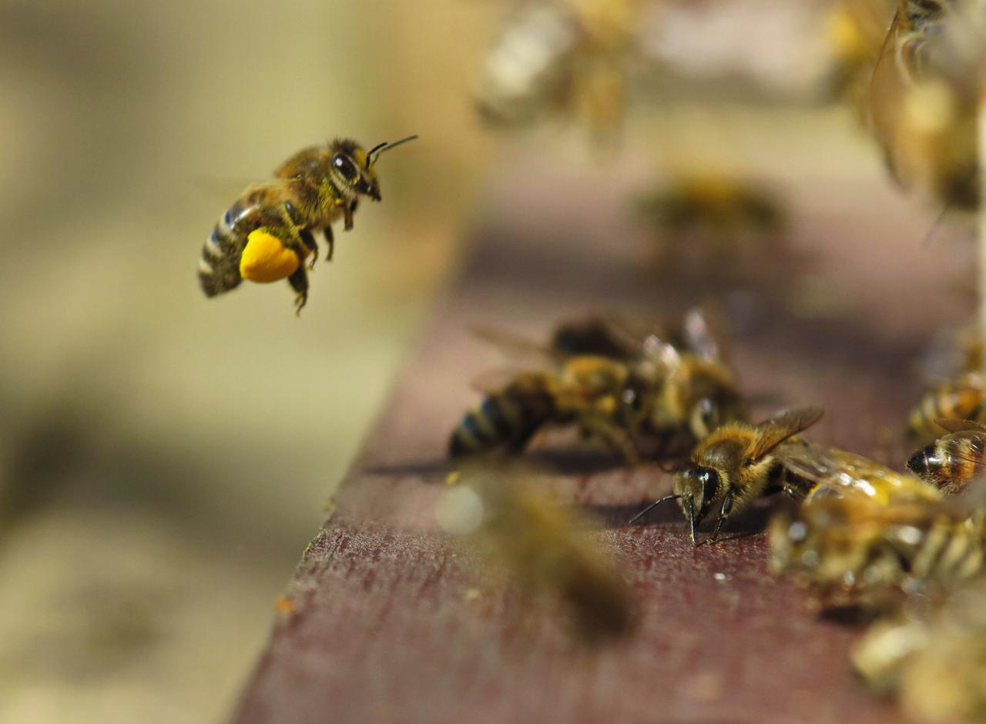
Team Introduction
Ashish Bhuyekar
Cybersecurity ASM (Attack Surface Management)
Data Management & Analytics
Supriya Pentewad
Cybersecurity ASM
Engineering
Pooja Joya
Cyber SRE
Jessica Gonsalves
Cybersecurity ASM
Ops Engineering
Kaustubh Singh
Cyber SRE

Slide 4
Proposed Solution
Audio Call
Video Call
Source
Meeting recordings are captured.
Stored at central location space allocated teamwise.
Processing
Audio and Video Data is processing.
Speech-to-text conversion is performed using ML algorithm.
Transcription
Transcription is recorded.
Stored at central location for records.
Action
Minutes-of-Meetings are sent over email.
Email would be sent across for the actions and tasks assigned.
Tasks are created in project planning tool e.g. JIRA.

Slide 5

Demo

Slide 6

Future Scope
Known Issues/Challenges
Input
Real-time audio recording/raw data collection during meeting is a challenge due to authentication/permission issue (recording voice of a user from a different system is a privacy violation).
Raw Data Processing
AI/ML models can be trained and improved for better accuracy of MoM.
Scalability
The proposed solution need to be scaled to integrate with third-party communication apps like Skype, Zoom, Teams, Webex, Rocket.Chat, etc.
Output
MoM to be sent to meeting participants via email.

Slide 7


Learnings
What have we learnt?
1
Team collaboration
8
To be open to diverse ideas
2
Delivering under pressure
4
Exploration of new areas of technology
7
Being accountable for one’s deliverable
3
To not give up
5
Leveraging diverse skill-set available
6
Be positive

Slide 8

Actions
Courses
Practical Python for Beginners: Pluralsight
By Sarah Holderness
Getting Started with Natural Language Processing with Python: Pluralsight
By Swetha Kolalapudi
Python for Data Analysts: Pluralsight
Learning Path

Slide 9
Feedback

